Slide 1
Privacy Enhancing Technologies
15-421/08-731 and 08-761/46-861 -- Fall 2013 – Lecture 12
Information Security & Privacy
Norman M. Sadeh
School of Computer Science
Carnegie Mellon University

Slide 2
Practical Info
Homework Assignment #2 due by midnight on Friday Oct. 11 (tomorrow)
Midterm (full-semester):
  Oct 15: 10:30-11:50am – NSH 1305
Final (mini-semester):
  46-861 Tepper : Friday, October 11, 9am to noon - 152 Posner Hall
  08-761 non-Tepper: Friday, October 18, 8:30am to 11:30am - 4215 Gates Hillman Center

Slide 3
Practical Info - Continued
Full Semester Students:
  Oct 17: Lecture 13: Mid-semester project presentations (NSH 1305 – usual class hours)
  Oct 22 and 24: No class: focus on your projects and come and see me during office hours to discuss your progress
  Oct 29: First class if mini-2

Slide 4
This Lecture: Overview
Legal & Regulatory framework: recap of last lecture
Different types of Privacy Enhancing Technologies
The Platform for Privacy Preferences (P3P)
  History, motivations/vision, objectives, obstacles
NSA Leaks: Discussion
Student Presentation: Skype Security
References for this lecture

Slide 5
FTC’s Fair Information Practices Principles
Restates FIP doctrine first formulated in 1973 in the context of online practices
  Influenced by OECD guidelines - Note: these are just guidelines!
Notice/awareness (core principle)
  Disclose practices
Choice/consent (core principle)
  Opt-in for PII and opt-out option for non-PII
Access/participation
  User should be able to review & correct his info
Security
  Ensure info is accurate and secure
Enforcement
  Mechanisms for handling violations

Slide 6
Different Types of Privacy Enhancing Techn.
Encryption techniques
  e.g. secure multi-party computation
Selective obfuscation
  K-anonymity and related concepts
  Allow the accuracy of disclosed information to vary
Architectures that minimize information disclosure
  e.g. submission of broad queries, where finer search is performed at the level of the client
Anonymization servers, inPrivate Browsing, DNT
Privacy policies
  Focus on disclosure and consent

Slide 7
Questions
How many of you regularly read Web site privacy policies?
How many of you read a Web site privacy policy over the past month?
….over the past 6 months?
…ever?
…just part of a policy?
How many of you care about privacy policies?
How many of you don’t?
How many of you are unsure?
How many of you think they should care but have just given up?

Slide 8
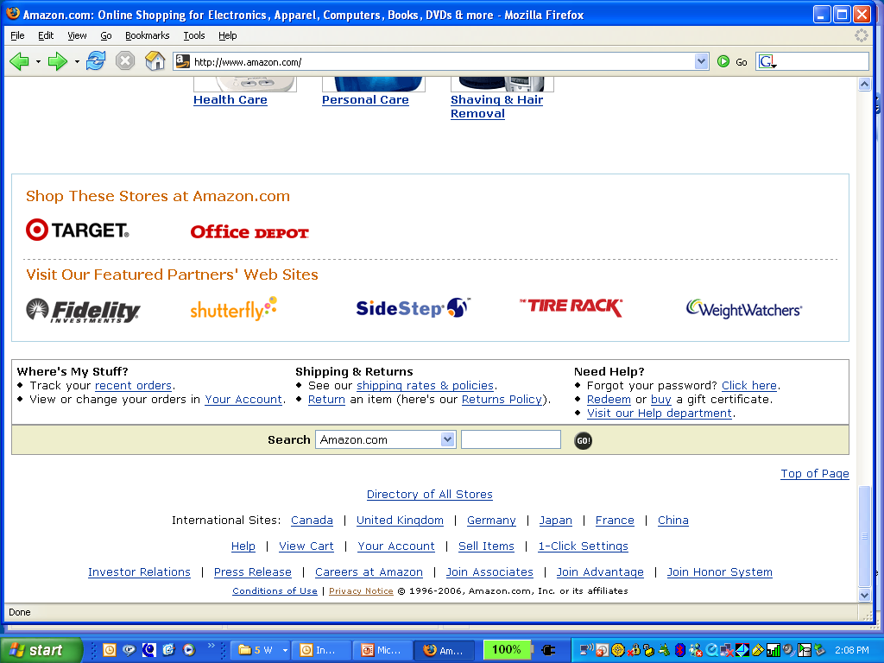
Reading Privacy Policies on the Web
Privacy notice

Slide 9
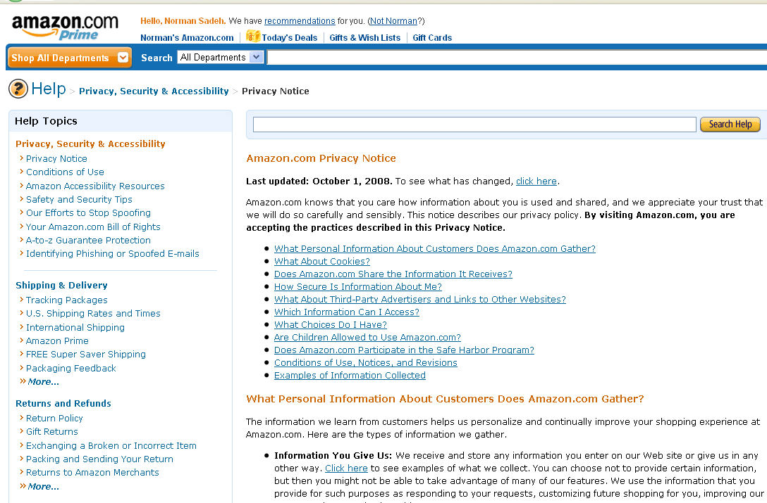
Reading Privacy Policies on the Web - II

Slide 10
Reading Privacy Policies on the Web - III
Business Transfers: As we continue to develop our business, we might sell or buy stores, subsidiaries, or business units. In such transactions, customer information generally is one of the transferred business assets but remains subject to the promises made in any pre-existing Privacy Notice (unless, of course, the customer consents otherwise). Also, in the unlikely event that Amazon.com, Inc., or substantially all of its assets are acquired, customer information will of course be one of the transferred assets.
Protection of Amazon.com and Others: We release account and other personal information when we believe release is appropriate to comply with the law; enforce or apply our Conditions of Use and other agreements; or protect the rights, property, or safety of Amazon.com, our users, or others. This includes exchanging information with other companies and organizations for fraud protection and credit risk reduction. Obviously, however, this does not include selling, renting, sharing, or otherwise disclosing personally identifiable information from customers for commercial purposes in violation of the commitments set forth in this Privacy Notice.
Etc. Source: Amazon privacy policy statement (2008)

Slide 11
Reading Privacy Policies on the Web - IV
What About Third-Party Advertisers and Links to Other Websites?
Our site includes third-party advertising and links to other websites. We do not provide any personally identifiable customer information to these advertisers or third-party websites. Click here for some examples as well as information on how to contact these companies to learn more or opt-out of their information collection practices.
These third-party websites and advertisers, or Internet advertising companies working on their behalf, sometimes use technology to send (or "serve") the advertisements that appear on our website directly to your browser. They automatically receive your IP address when this happens. They may also use cookies, JavaScript, web beacons (also known as action tags or single-pixel gifs), and other technologies to measure the effectiveness of their ads and to personalize advertising content. We do not have access to or control over cookies or other features that they may use, and the information practices of these advertisers and third-party websites are not covered by this Privacy Notice. Please contact them directly for more information about their privacy practices. In addition, the Network Advertising Initiative offers useful information about Internet advertising companies (also called "ad networks" or "network advertisers"), including information about how to opt-out of their information collection.
Source: Amazon privacy policy statement (2008)

Slide 12
Reading Privacy Policies on the Web - V
What Choices Do I Have?
As discussed above, you can always choose not to provide information, even though it might be needed to make a purchase or to take advantage of such Amazon.com features as Your Profile, Wish Lists, Customer Reviews, and Amazon Prime.
You can add or update certain information on pages such as those referenced in the "Which Information Can I Access?" section. When you update information, we usually keep a copy of the prior version for our records.
If you do not want to receive e-mail or other mail from us, please adjust your Customer Communication Preferences. (If you do not want to receive Conditions of Use and other legal notices from us, such as this Privacy Notice, those notices will still govern your use of Amazon.com, and it is your responsibility to review them for changes.)
If you do not want us to use personal information that we gather to allow third parties to personalize advertisements we display to you, please adjust your Advertising Preferences.
The Help portion of the toolbar on most browsers will tell you how to prevent your browser from accepting new cookies, how to have the browser notify you when you receive a new cookie, or how to disable cookies altogether. Additionally, you can disable or delete similar data used by browser add-ons, such as Flash cookies, by changing the add-on's settings or visiting the Web site of its manufacturer. However, because cookies allow you to take advantage of some of Amazon.com's essential features, we recommend that you leave them turned on. For instance, if you block or otherwise reject our cookies, you will not be able to add items to your Shopping Cart, proceed to Checkout, or use any Amazon.com products and services that require you to Sign in.

Slide 13
User Burden Considerations - I
Amazon’s policy is one of the clearest on the Web…
Recent study: It takes an average of 10 minutes for someone to read a privacy policy - http://www.out-law.com/page-9490
  Some policies have as many as 15 pages!

Slide 14
User Burden Considerations - II
  Even skimming a simple policy to answer a few questions typically takes 3-6 minutes
  Does this policy allow Acme to put you on an email marketing list? (71% correct answers)
  Does this policy allow Acme to share your email address with a marketing company that might put you on their email marketing list? (52% correct answers)

Slide 15
The Platform for Privacy Preferences – P3P
Developed by the World Wide Web consortium
  Final P3P 1.0 recommendation issued in April 2002
Offers an easy way for Web sites to communicate their privacy policies in a standard machine-readable format
Enables the development of new tools:
  e.g. comparing policies with user preferences, summarizing policies, alerting users, privacy-aware search engines, etc.

Slide 16
Question
What are the advantages of an approach like P3P?
  For consumers
  For businesses
  For government
What are some of the possible disadvantages of an approach like P3P?
  For consumers
  For businesses
  For government

Slide 17
P3P is Part of the Solution
P3P1.0 aims to help users understand privacy policies
It complements:
  Seal programs and regulations
  Anonymity tools
  Encryption tools
  Laws and codes of practice
    Note: It can also help support laws (e.g. European P3P pilot)

Slide 18
Basic Components
A standard XML format to encode web site privacy policies
Policy reference files: which policy applies to which part of the site
Optionally includes “compact policies”
  Web server configured to issue special P3P headers when cookies are set
No special server software required
Requires client software to read P3P policies
  “P3P user agent”

Slide 19
Legal Issues
P3P does not address legal standing of P3P policies or include enforcement mechanisms
P3P specs requires P3P policies to be consistent with natural language privacy policies
  The level of detail may be different
In some jurisdictions, regulators and courts may treat P3P policies equivalently to natural language policies

Slide 20
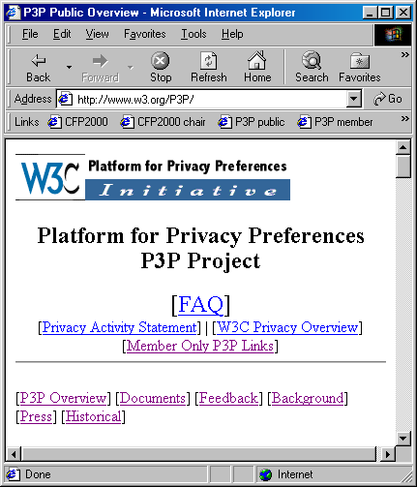
A Simple HTTP Transaction
Web
Server
GET /index.html HTTP/1.1
Host: www.att.com
. . . Request web page
HTTP/1.1 200 OK
Content-Type: text/html
. . . Send web page
Source: L. Cranor

Slide 21
…with P3P 1.0 added
GET /w3c/p3p.xml HTTP/1.1
Host: www.att.com
Request Policy Reference File
Web
Server
Send Policy Reference File
Request P3P Policy
Send P3P Policy
GET /index.html HTTP/1.1
Host: www.att.com
. . . Request web page
HTTP/1.1 200 OK
Content-Type: text/html
. . . Send web page
Source: L. Cranor

Slide 22
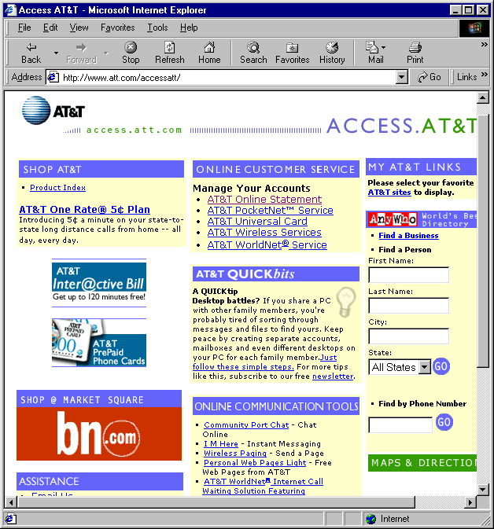
P3P Increases Transparency
P3P clients can check a privacy policy each time it changes
P3P clients can check privacy policies on all objects in a web page, including ads and invisible images
http://www.att.com/accessatt/
http://adforce.imgis.com/?adlink|2|68523|1|146|ADFORCE
Source: L. Cranor

Slide 23
What’s in a P3P Policy?
Name and contact information for site
The kind of access provided to users to their data
Mechanisms for resolving privacy disputes
The kinds of data collected
How collected data is used, and whether individuals can opt-in or opt-out of any of these uses
Whether/when data may be shared and whether there is opt-in or opt-out
Data retention policy
Source: L. Cranor

Slide 24
Example of Privacy Policy
We do not currently collect any information from visitors to this site except the information contained in standard web server logs (your IP address, referer, information about your web browser, information about your HTTP requests, etc.). The information in these logs will be used only by us and the server administrators for website and system administration, and for improving this site. It will not be disclosed unless required by law. We may retain these log files indefinitely. Please direct questions about this privacy policy to privacy@p3pbook.com.
Source: L. Cranor

Slide 25
P3P – XML Encoding
P3P version
<POLICIES xmlns="http://www.w3.org/2002/01/P3Pv1">
<POLICY discuri="http://p3pbook.com/privacy.html"
name="policy">
<ENTITY>
<DATA-GROUP>
<DATA
ref="#business.contact-info.online.email">privacy@p3pbook.com
</DATA>
<DATA
ref="#business.contact-info.online.uri">http://p3pbook.com/
</DATA>
<DATA ref="#business.name">Web Privacy With P3P</DATA>
</DATA-GROUP>
</ENTITY>
<ACCESS><nonident/></ACCESS>
<STATEMENT>
<CONSEQUENCE>We keep standard web server logs.</CONSEQUENCE>
<PURPOSE><admin/><current/><develop/></PURPOSE>
<RECIPIENT><ours/></RECIPIENT>
<RETENTION><indefinitely/></RETENTION>
<DATA-GROUP>
<DATA ref="#dynamic.clickstream"/>
<DATA ref="#dynamic.http"/>
</DATA-GROUP>
</STATEMENT>
</POLICY>
</POLICIES>
Location of
human-readable
privacy policy
P3P policy name
Site’s
name
and
contact
info
Access disclosure
Human-readable
explanation
Statement
How data may
be used
Data recipients
Data retention policy
Source: L. Cranor
Types of data collected

Slide 26
Compact Policies - I
Provide very short summary of full P3P policy for cookies
Not required
Must be used in addition to full policy
May only be used with cookies
Must commit to following policy for lifetime of cookies
May oversimplify site’s policy
IE relies heavily on compact policies for cookie filtering – especially an issue for third-party cookies
Source: L. Cranor

Slide 27
Compact Policies - II
P3P policies must declare all the data stored in a cookie as well as any data linked via the cookie
P3P policies must declare all uses of stored and linked cookie data
Based on subset of P3P vocabulary:
  Access, categories, disputes, purpose, recipient, remedies, retention, etc.

Slide 28
User Privacy Preferences
P3P 1.0 user agents may optionally take action based on user preferences
  IE6.0 allows users to set privacy preferences with regard to cookies
  APPEL (“A P3P Preference Exchange Language”) offers users a number of canned choices (e.g. reject, accept, prompt user)

Slide 29
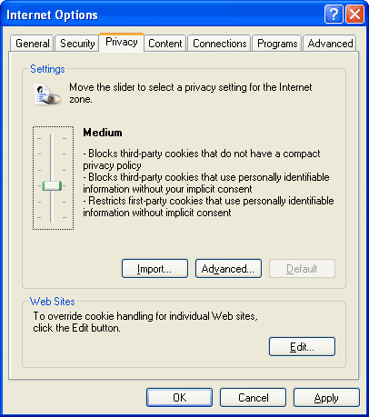

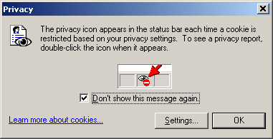
P3P in IE6.0 (not very different in IE8.0)
Automatic processing of compact policies only;
third-party cookies without compact policies blocked by default
Privacy icon on status bar indicates that a cookie has been blocked – pop-up appears the first time the privacy icon appears

Slide 30
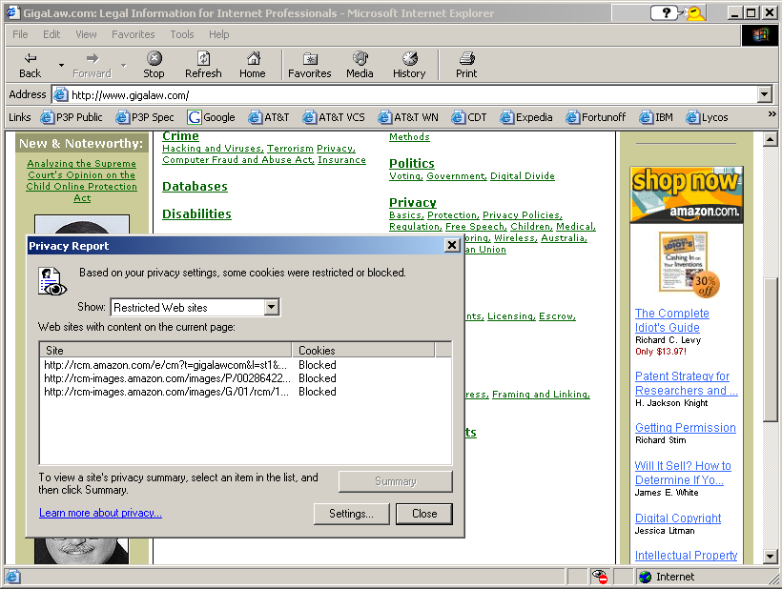
P3P in IE - II
Users can click on
privacy icon for
list of cookies;
privacy summaries
are available at
sites that are
P3P-enabled
Source: L. Cranor

Slide 31
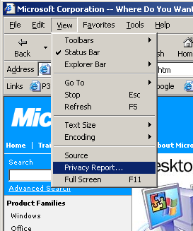
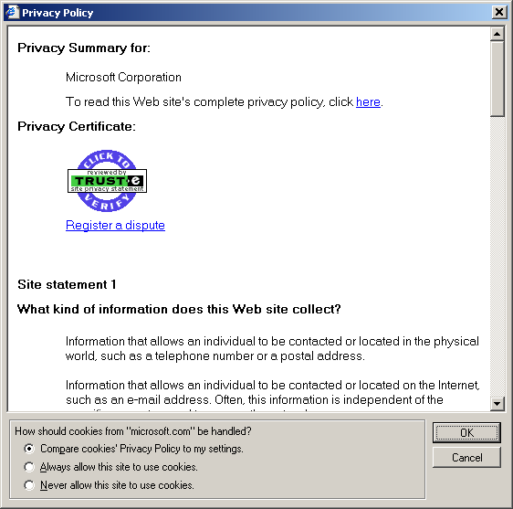
P3P in IE6 - III
Privacy summary report is
generated automatically
from full P3P policy
Source: L. Cranor

Slide 32
APPEL - Sample User Preferences
Requests for personal info which will be given out to 3rd parties should be blocked
The user doesn’t mind revealing click-stream and user agent information to sites that collect no other information, provided the service has a trust seal of some kind
The user is comfortable giving out her first and last name, as long as it is for non-marketing purposes
  She requires assurance from TRUSTe and wants to be prompted
When interacting with her bank, she accepts any data requests, as long as information is not passed on to 3rd parties

Slide 33
AT&T Privacy Bird
Chirping bird is privacy indicator
  Information only – no action
Source: L. Cranor

Slide 34
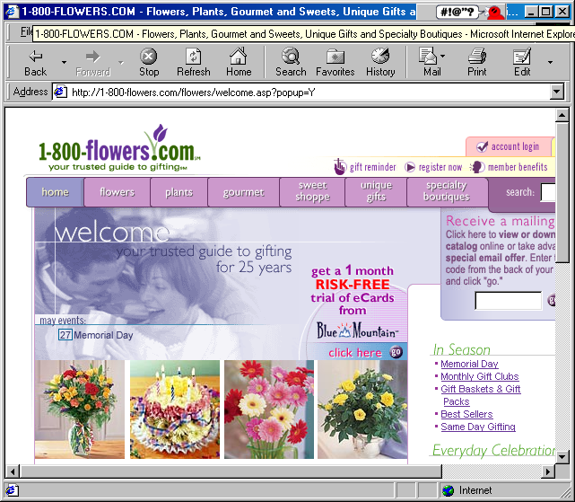
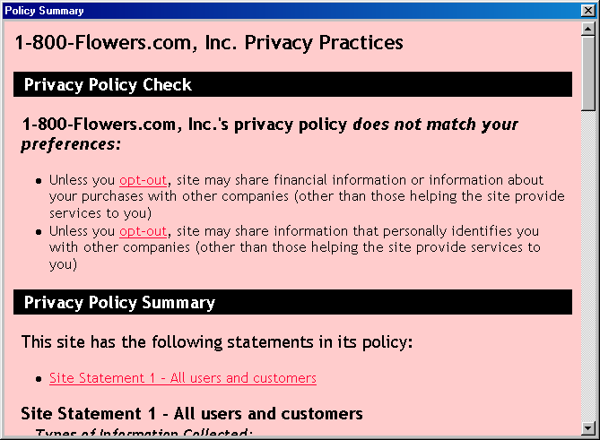
Privacy Bird – Policy Mismatch Example
Source: L. Cranor

Slide 35
P3P: Open Questions
Usability
Enforceability
  Technology
  Legal issues
Multi-channel issues
Multi-jurisdictional issues
Multi-organizational issues

Slide 36
Illustration of these Limitations
Study published Sept 2010:
  1/3 of 33,000 websites have technical errors that cause IE to allow cookies to install, even if browser settings are set to reject them….
  Including 21 of the top 100 most popular sites such as Facebook, Amazon, AOL, Mapquest, GoDaddy, and Hulu…
  IE just allows ill-formatted compact policies
Can you think of a solution?

Slide 37
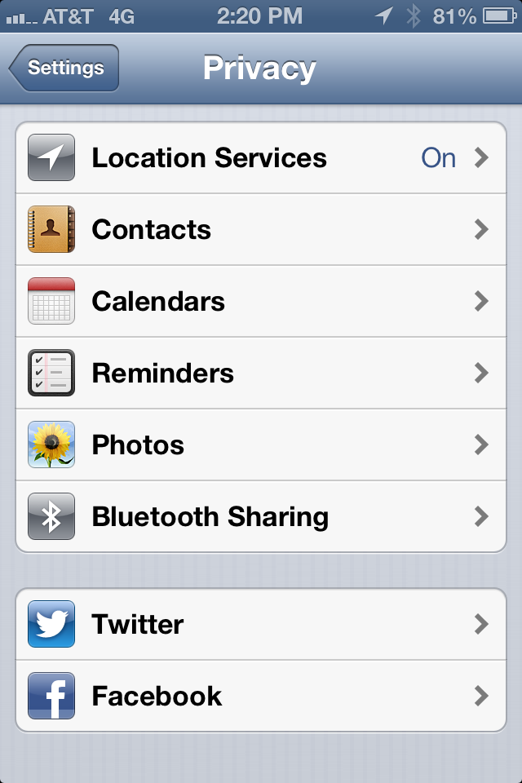
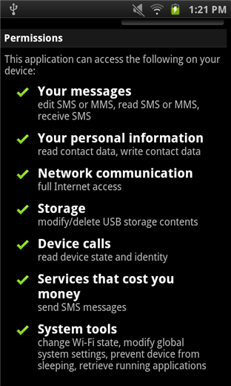
Explosion in Number of Privacy Settings
Android Permissions
iOS
-How can a user be expected to
make sense out of this?

Slide 38
Usability Challenges
How do you capture people’s preferences?
    Does everyone have the same preferences?
      Can we identify a small number of default profiles (e.g. IE for cookies)
    Can you expect people to be willing to specify their preferences?
    Do people understand their privacy preferences?
    Can privacy preferences be learned by observing users?
Pervasive computing – access to an ever broader range of contextual attributes
  Location, calendar, preferences, etc.

Slide 39
Different Solutions Being Pursued
Identify small number of default privacy policies/privacy “personas”
Use machine learning to learn people’s preferences and help them refine their preferences
Provide better auditing functionality/be more transparent
  For users to review how their information is being used
    Includes education & explanation

Slide 40
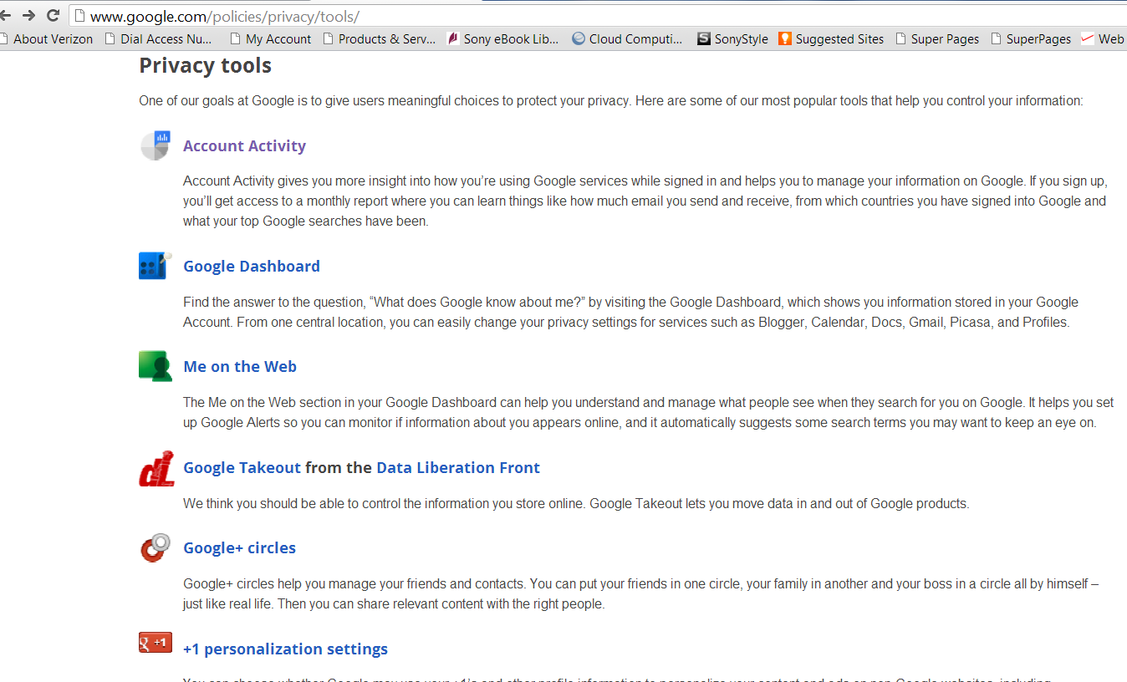
Google as an Example

Slide 41
Google Dashboard
Integrated view of your data across all Google “properties”/products
Google docs
YouTube
Gmail
Latitude
Maps
Talk
Picasa
Google profile
Android
Calendar
Contacts
etc.

Slide 42
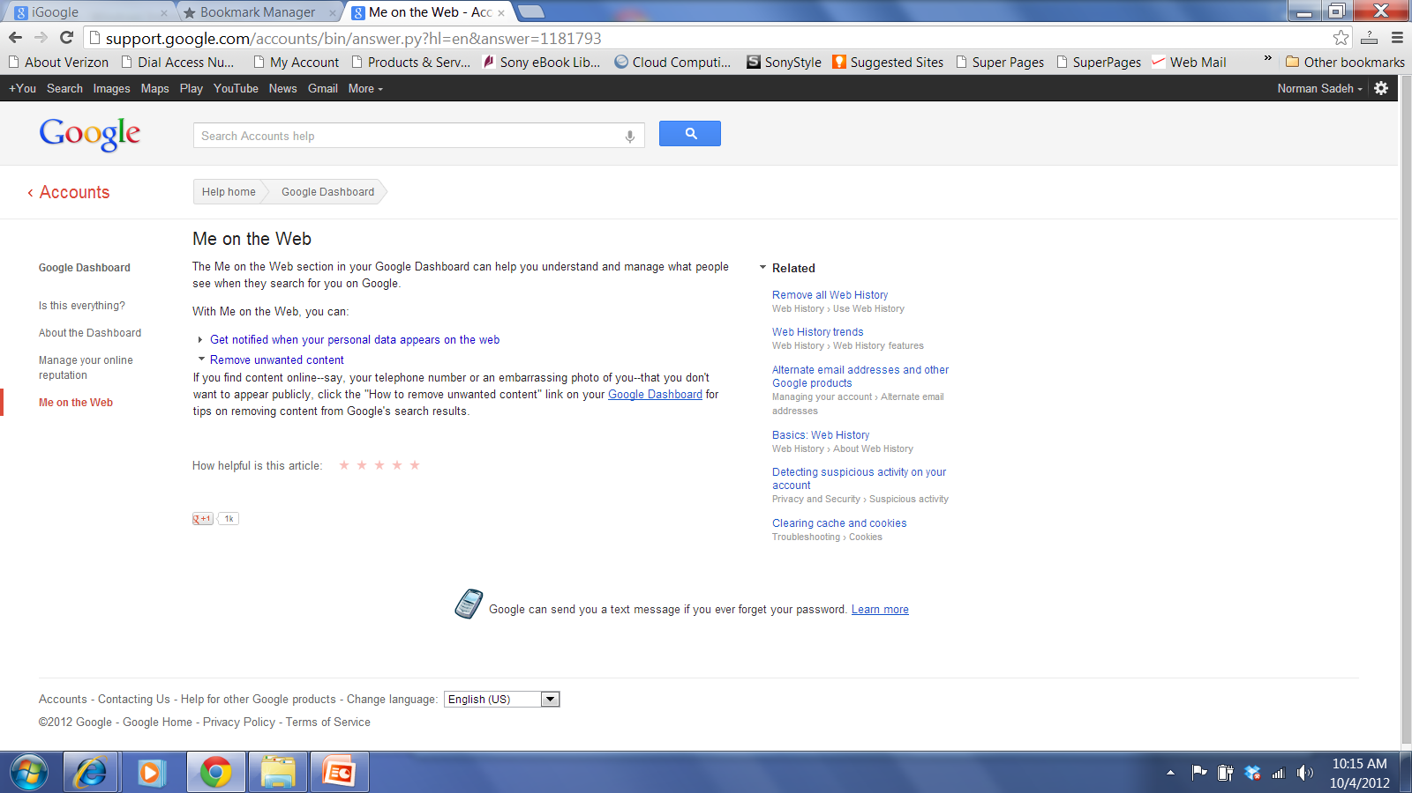
Me on the Web

Slide 43
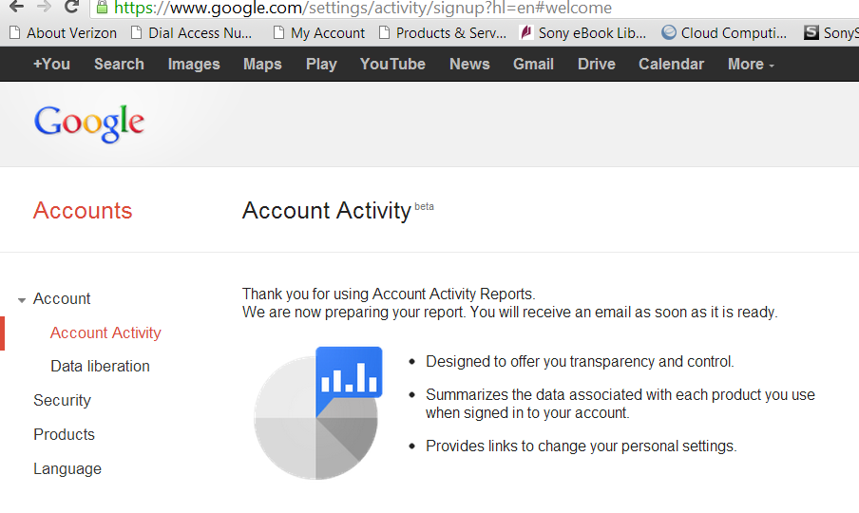
Google: Account Activity – More Transparency

Slide 44
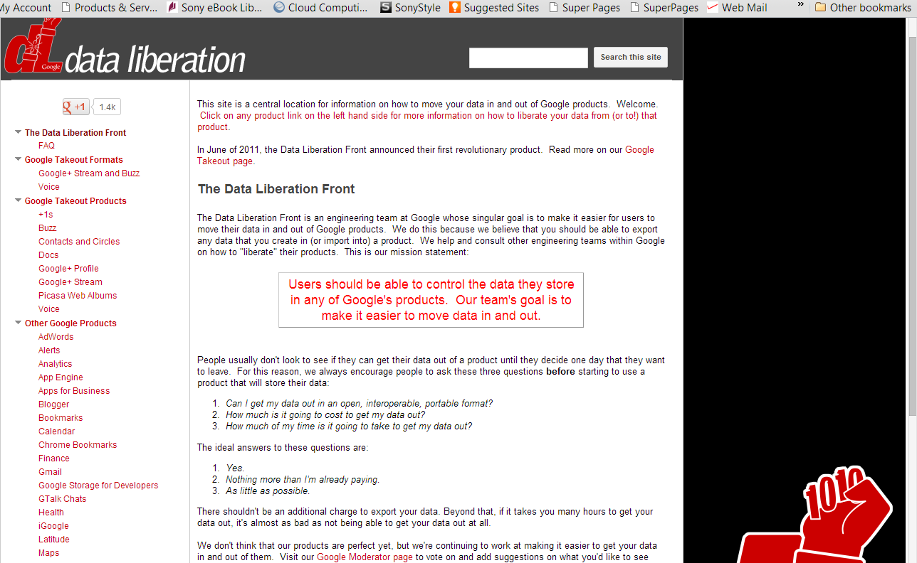
Google Data Liberation Front

Slide 45
Question
How many of you have used these tools?
Which tools?

Slide 46
2013 Mass Surveillance Disclosures
Class Discussion
A good source of information: http://en.wikipedia.org/wiki/2013_mass_surveillance_disclosures

Slide 47
Historical Background
June 6, 2013: The Guardian and Washington Post publish first articles based on material leaked by Edward Snowden – followed by a series of articles with additional details
June 14, 2013: Snowden charged under the Espionage Act of 1917
Strong public reaction domestically and internationally
Apology by National Intelligence Director for giving Congress false testimony while under oath
President sets up an NSA Review Panel
Fallout is not over

Slide 48
What We Knew Before
ECHELON (e.g. European Parliament report)
International surveillance
Wiretapping
Financial transactions
And more
Bolstered in part by laws passed post 9/11:
  Patriot Act
  FISA Amendments Act
  Protect America Act

Slide 49
What We Learned - I
(Assuming the allegations are correct)
Global surveillance program involving partner countries and cooperation from major industry players
Not limited to combating terrorism – also surveillance of foreign governments and possibly industrial espionage
Includes ability to collect domestic data
  Involves bulk collection
Includes backdoors in popular software and successful track record at cracking popular security protocols & devices
Many contractor and government employees have access to data/functionality
A number of incidents where protocols and safeguards were not followed

Slide 50
What We Learned - II
Relies on system of secret courts, panels and judges
  FISA Courts
  Supreme Court involvement
  Secrecy provided by FISA and Patriot Act
Public unaware of these practices
  Many seemingly uncomfortable about what they hear or about lack of information

Slide 51
Some Questions for Discussion
Should the government have the right to:
  Monitor our communication (e.g. knowing who we call, for how long, etc)
    Anytime, never, only under some circumstances
  Listen to our phone conversations, read our email, listen in on Skype calls?
    Anytime, never, only under some circumstances
If, as alleged, large companies are collaborating with the government without our knowledge, are they breaking our trust?
    Should government be allowed to force companies to create backdoors?
    What does it mean for global commerce?
How should Snowden be treated? (“Hero or Traitor?”)

Slide 52
References for this Lecture
Required Readings:
  Garfinkel, “Web Commerce, Security and Privacy”, O’Reilly, 2nd Edition, Ch. 10 and 24
Optional Readings:
  L. Cranor, “Web Privacy with P3P”, O’Reilly, 2002
  http://en.wikipedia.org/wiki/2013_mass_surveillance_disclosures
  N. Sadeh, L. Cranor, J. Hong M. Prabaker, J. Rao, I. Fette, P. Kelley"Understanding and Capturing People's Privacy Policies in a People Finder Application", 2007 Ubicomp Workshop on Privacy, Austria, Sept. 2007 - http://www.cs.cmu.edu/~sadeh/Publications/More%20Complete%20List/Ubicomp%20Privacy%20WS%20version%20for%20the%20web.pdf
  www.w3.org/TR/WD-P3P-preferences
  R. Richmond: “A Loophole Big Enough for a Cookie to Fit Through”, sept 17, 2010 - http://bits.blogs.nytimes.com/2010/09/17/a-loophole-big-enough-for-a-cookie-to-fit-through/
  Data Mining and Privacy: http://www.dmreview.com/article_sub.cfm?articleId=7768
Acknowledgement:
  This lecture is in part based on Lorrie Cranor’s P3P slides at http://p3pbook.com/slides.html

Slide 53

Q&A

